Slide 1
Right Heart Valves
Neeraj Jain, MD , FACC
Raja W. Dhurandhar Professor of Medicine
LSU Health—New Orleans
CVD Fellowship Program Director
Louisiana ACC Chapter Governor
No Disclosures or Conflicts of Interests

Slide 2
Question 1
Unlike the relationship of the mitral and aortic valve leaflets, it is uncommon to see direct extension of tricuspid valve endocarditis to the pulmonic valve due to the presence of what anatomic RV structure?
A. Moderator band
B Ventriculo-infundibular fold
C. Crista terminalis
D. Septomarginal band

Slide 3
Question 2
Which of the following is LEAST effective in improving
RVSP assessment accuracy from the following TR jet spectral Doppler envelope?
A. Set the sweep speed to 100 mm/s.
B. Increase the 2D gain
C. Increase the dynamic range.
D. Administer saline bubbles.
E. Decrease displayed Doppler velocity scale.

Slide 4
Question 3
Which of the following is correct regarding typical findings associated with Ebstein anomaly?
A. Septal and anterior leaflet fusion resulting in TR.
B. RV-laminated, sail-like anterior TV leaflet.
C. Decreased size of anatomic TV annulus.
D. Apical rotation of functional TV annulus
E. Increased right ventricular volume.

Slide 5
Question 4
A patient diagnosed recently with a small anterior leaflet TV vegetation presents for repeat TTE. Which of the following views is most likely to show the anterior TV leaflet?
A. Parasternal RV inflow
B. Parasternal short axis.
C. Apical RV focused.
D. Apical 3 chamber.
E. Apical 4 chamber.

Slide 6
Question 5
What is the cause of the blue Doppler signal in the subpulmonic/RVOT region on this TTE?
A. PR with inverted Nyquist.
B. PR with too low Nyquist limit and aliasing.
C. VSD associated with Trisomy 21.
D. VSD associated with Fallot’s Tetralogy.
E. Something else/Don’t know

Slide 7
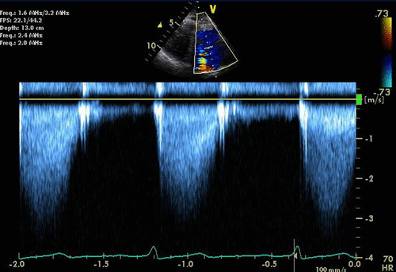
Question 6
A 29 year old woman is in her second trimester of pregnancy. Due to systolic murmur and mild exertional dyspnea, an echocardiogram is performed with the following CW tracing across the pulmonic valve. Which of the following correctly characterizes the next step in pregnancy counseling?
A. Continue pregnancy, PS is no biggie
B. PS gradient warrants balloon valvuloplasty.
C. PS gradient warrants pregnancy termination.
D. What PS ?? You mean supracristal VSD.

Slide 8
Question 7
30 yo woman is s/p TOF repair with bioprosthetic valve. Images shown are from standard parasternal windows. Based upon the images, which of the following is LEAST LIKELY to be found?
A. RV hypo-
kinesis
B. Sinus rhythm
C TS & TR
D. PS & PR
E. Elevated RVEDP.
F. RAp > PA diastolic pressure before S1 heart sound
G. All above are demonstrated
Notes:
Knowledge and understanding of TOF includes management of pulmonic stenosis, which in this case a bioprosthetic valve was mentioned in the question stem. The tricuspid valve is not usually involved in any TOF classical pathology and thus TS and TR should not be expected at any point in the patient’s lifetime. There is end diastolic forward flow seen through the pulmonic valve just before the onset of systole (S1 auscultatory sound). Steep slope of PI jet indicates elevated RVEDP with equalization of pressures. Transmitral M mode clearly shows opening of the mitral valve late in diastole associated with presumably sinus rhythm, though the ECG tracing voltage gain is set low.

Slide 9
Questions 8,9,10: TRUE or FALSE
Diastolic tricuspid VTI of 30cm → Severe TS?
Tricuspid pressure half time < 190 msec → Severe TS?
Tricuspid regurgitant volume of 50 cc/beat → severe TR?

Slide 10
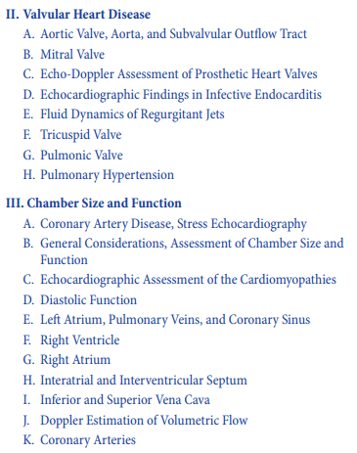
2020 ASCeXAM Examination Content Outline

Slide 11
Natural History of TR and Future Therapeutic Direction
Patients with isolated TR or TR
Associated with left heart disease
Carry excess morbidity & mortality.
Whether transcatheter approaches
To reduce TR will be clinically
effective remains to be elucidated.

Slide 12
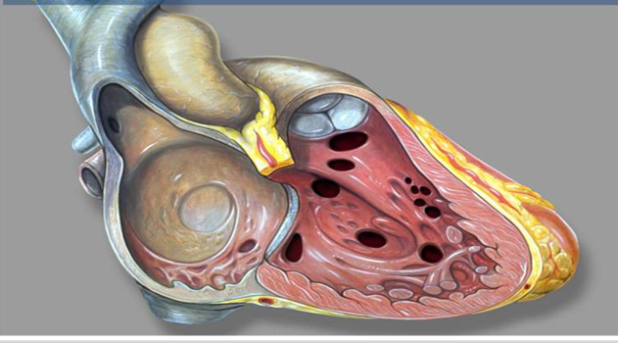
Right Ventricle Anatomy
3 Sections
INLET
TV, chordae & Pap m.
APICAL
Trabeculations
OUTLET (CONUS)
Smooth outflow region

Slide 13
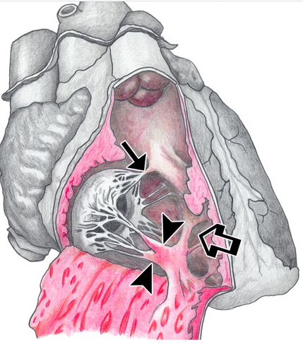
Right Ventricular Anatomy
3 Bands:
Parietal band
Septomarginal band
Moderator band
VIF
Ventriculo-infundibular fold
Aka crista supraventricularis
Separates inlet from outlet (thus TV from PV)
Forms posterior RVOT
VIF

Slide 14
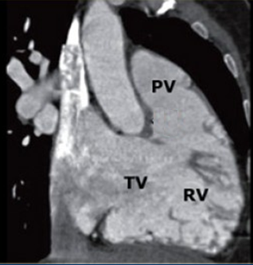
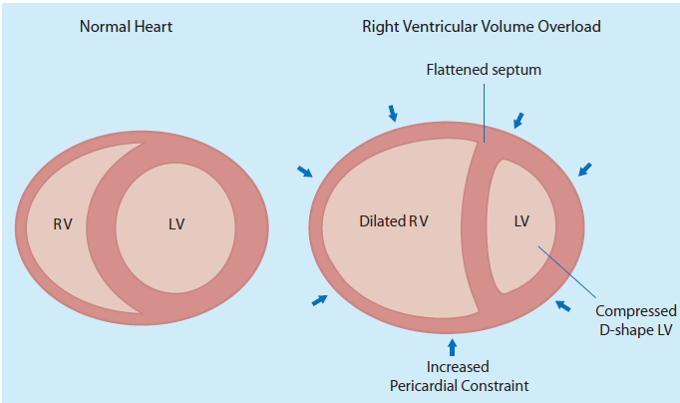
RV Shape
Shape of the RV is complex.
appears triangular from the side
crescent shaped in cross section
RV shape is influenced by the IVS position.
* There is no adequate geometric shape that can be used as a model for calculation of RV chamber volumes
in diastole
Haddad et al. Circulation Volume 117, Issue 13, 1 April 2008

Slide 15
RV Volume Overload Pattern
ASSOCIATED WITH:
IVS
Shunt (before TV level)
ASD
Anomalous PV return
NOT: typical VSD or PDA or AV fistula. Not PFO.
Valve regurgitation
Severe TR
Severe PR
RV myopathy
RV infarct
ARVC
Storage disease
MV

Slide 16
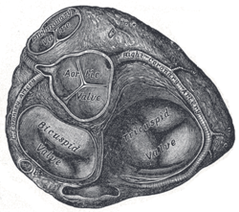
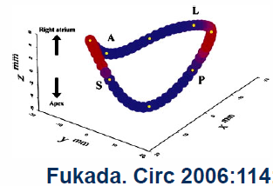
TV Anatomical Considerations
TV annulus is larger and more complex than MV.
TV leaflets are thinner than MV
Leaflets are of unequal size
There may be 2-4 leaflets as less common variants.
TV annulus is both “D”-shaped and non-planar with high and low points.
3D Shape of the Tricuspid Annulus. Jason H. Rogers, and Steven F. Bolling Circulation. 2009;119:2718-2725
Notes:
The tricuspid annulus has a complex shape being simultaneously D-shaped and saddle-shaped. The linear part of the D shape is also a planar aspect of the annulus and is where the septal leaflet attaches.

Slide 17
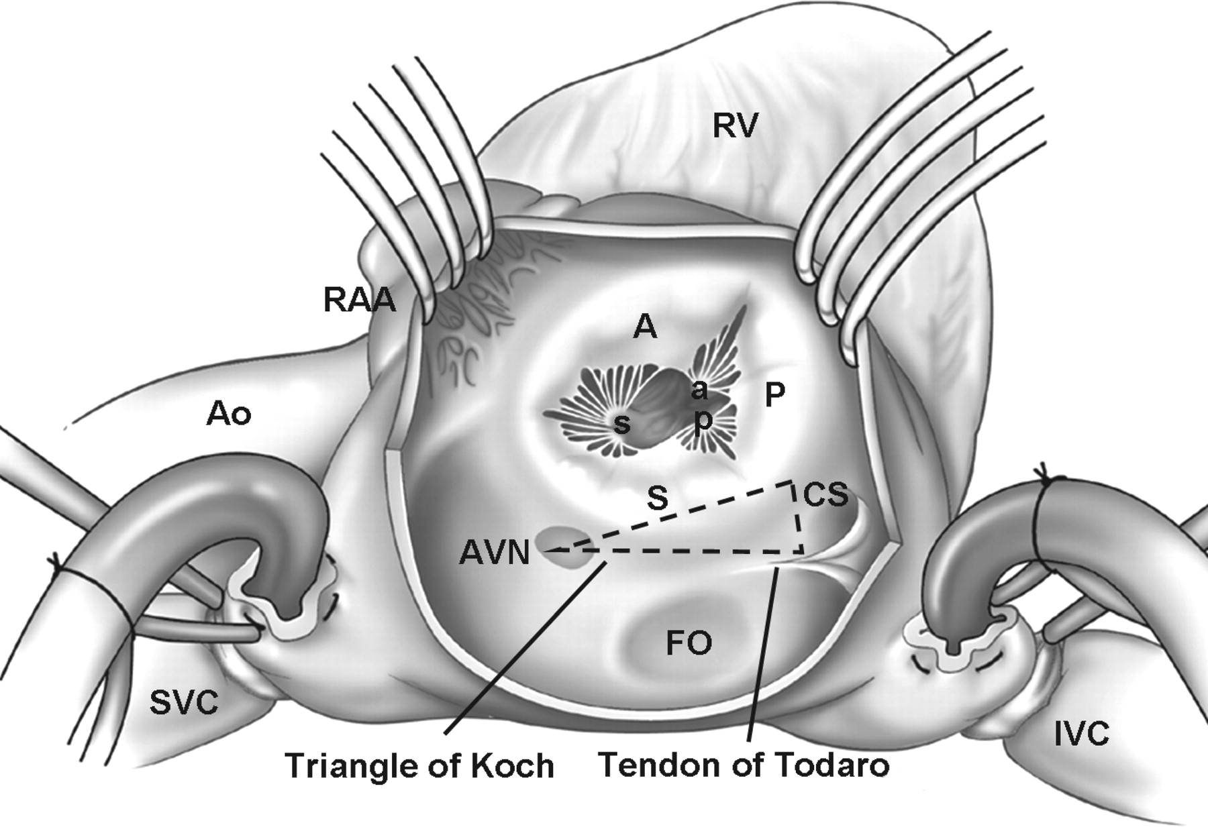
Surgical perspective of the TV complex
3 leaflets. 2 main papillary muscles (ant & post) with rudimentary septal pap m. Some chordae arising directly from the septum.
Jason H. Rogers, and Steven F. Bolling Circulation. 2009;119:2718-2725
Copyright © American Heart Association, Inc. All rights reserved.
Notes:
Figure 1. Surgical perspective of the tricuspid valve complex. The tricuspid valve consists of three leaflets: anterior (A), posterior (P), and septal (S). There are 2 main papillary muscles, anterior (a) and posterior (p). The septal papillary muscle (s) is rudimentary, and chordae tendinae arise directly from the ventricular septum. Relevant adjacent structures include the atrioventricular node (AVN), coronary sinus ostium (CS), and the tendon of Todaro, which form the triangle of Koch. Ao indicates aorta; FO, foramen ovale; IVC, inferior vena cava; SVC, superior vena cava; RAA, right atrial appendage; and RV, right ventricle.

Slide 18
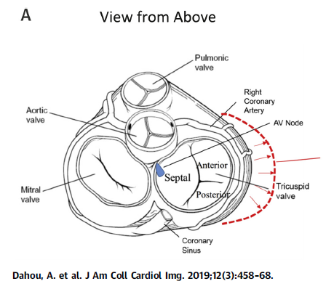
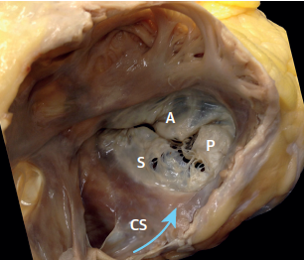
TV Leaflets
Anterior leaflet is the largest and most mobile.
Septal leaflet is least mobile.

Slide 19
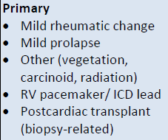
Primary and Secondary TR
BMJ 2015
The pathophysiology of secondary TR is related to:
RV and annular dilatation
Leaflet tethering in connection to pulmonary hypertension.
As the TV annulus dilates, the septal aspect is spared.
Annulus becomes more circular and planar.

Slide 20
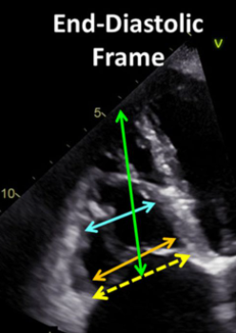
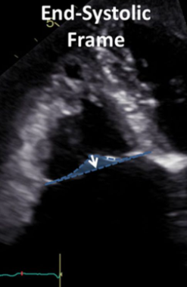
Secondary TR Caveats
Idiopathic TR:
Basal RV and annulus dilates
Normal RV length.
Normal tenting height.
Functional TR in pts with Pulm HTN:
RV length increases (green line)
Not much basal dilatation
Significantly greater tenting height.
Our understanding of when to intervene on these patients continues to evolve with our understanding of the complex relationship among the RV valve and annulus.
Dashed
Line =
Annular
Diameter
(>40 mm)
Tenting
Area
(>1.63cm²)
&
Height
(>.76 cm)

Slide 21
“Standard” Tricuspid Valve Views Leaflet designations as listed are variable in practice
TTE
TEE
Source: Feigenbaum, 7th ed, 2010
Notes:
These are the standard views for TTE and TEE for attempting to assess tricuspid leaflet anatomy and pathology.

Slide 22
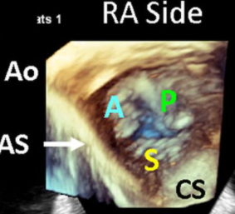
3D Echo of the Tricuspid Valve: Tips
En face TV view from either RA or RV side
IAS placed at 6 o’clock.
Since RV is anterior, TTE may be better than TEE for 3D.
For closed TV leaflets, use apical views.
For opened TV leaflet assessment, use parasternal views.

Slide 23
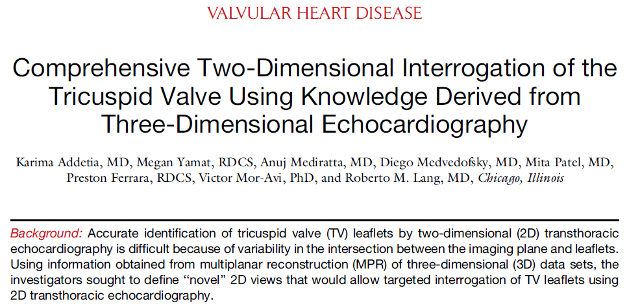
JASE January 2016
“Three-dimensional analysis in our study resulted in data that challenge the textbooks and guidelines, as they demonstrate that it is impossible to predict with certainty the TV leaflet combination visualized in any of the standard 2D views.”

Slide 24
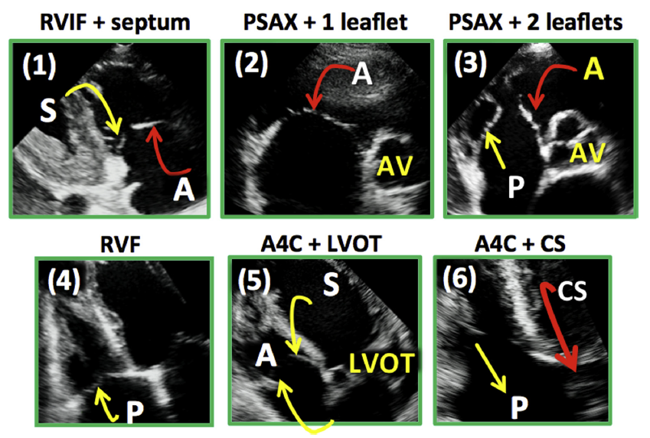
TricuspidValve Echo Anatomy Updated
OLD STANDARD
NEW VIEWS
Lower figure source: Addetia, et al.
JASE 2016

Slide 25
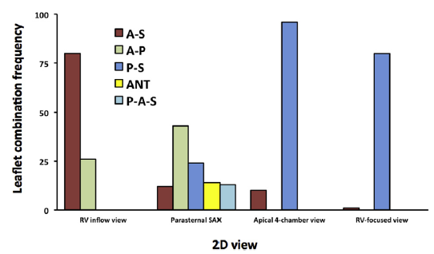
RVIF PSAX | A4C | RV Focused
Mild angulation results in variation in the PSAX
Knowledge of landmarks helps differentiate leaflets
Addetia, et al. JASE 2016

Slide 26
RVIF PSAX | A4C | RV Focused
Mild angulation results in variation in the PSAX
Knowledge of landmarks helps differentiate leaflets
Addetia, et al. JASE 2016

Slide 27
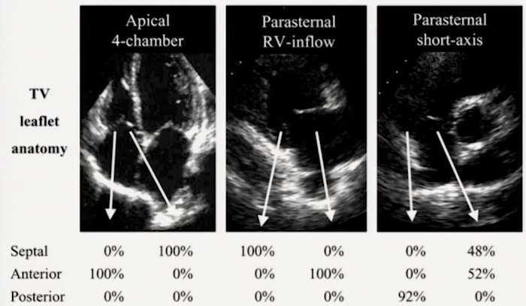
Agreement among publications in only one leaflet in RVIF and A4c views
Anwar et al, Int J Cardiovasc Imaging 2007 23:717-24

Slide 28
2D Landmarks for TV leaflet identification
Posterior leaflet is associated with seeing the CS.
Septal leaflet is associated with seeing the LVOT.
Anterior leaflet is associated with seeing the AV.

Slide 29
Illustrative Case 1: 35 yo woman
M-Mode: Diastolic IVS paradoxical flattening indicating RV volume overload.

Slide 30
RV Inflow
Notes:
Anterior and posterior leaflets are shown here as most commonly seen in the RV inflow view. Vegetation is only seen on anterior leaflet which is reliably seen in this view. Note how there RV abuts the liver and the coronary sinus is seen indicating the posterior leaflet. Importantly, the interventricular septum is not seen in this view giving confidence to the lack of septal leaflet visualization.

Slide 31
Color Doppler: RV inflow & SAX
Notes:
TR is severe; let’s get this determination out of the way.

Slide 32
TV in SAX View
Notes:
In this view, one leaflet is predominantly seen compatible with the anterior leaflet. There are 2 vegetation “bellies” seen.

Slide 33
Absence of septal leaflet involvement
*
Asterisk indicates LVOT. Note the
absence of the coronary sinus.
Notes:
The septal leaflet can be seen in this apical view with confidence. The opposite leaflet--because of the lack of the posteriorly situated coronary sinus in the view—is the anterior leaflet with the vegetation.

Slide 34
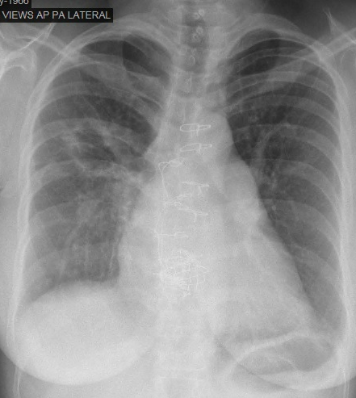
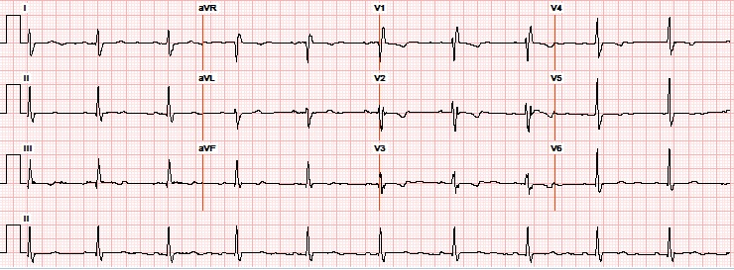
Congenital Disease Case
51 yo woman s/p PDA and ASD repair at age 19 who underwent a bioprosthetic TVR at age 47. She has dyspnea on exertion and edema.
Notes:
Pt is Vanessa Peters from St. Charles clinic MRN S. Patient with RBBB and straightening of the left heart border on chest X-ray.

Slide 35
Tricuspid Bioprosthesis
Notes:
One can see thickening and poor separation of the leaflets on 2D only imaging as well as some degree of TR and a diastolic flow acceleration on the right atrial side of the bioprosthetic tricuspid valve suggesting degenerative stenosis.

Slide 36
Doppler across prosthetic TV
Notes:
Color across the TVR shows turbulence compatible with significant stenosis. CW Doppler across the tricuspid bioprosthesis. Trans-tricuspid mean gradient of 20 mm Hg indicating very severe TS. She was not a candidate for 3rd surgical sternotomy reoperation and thus was referred for Melody Valve implantation (Valve in Valve).

Slide 37
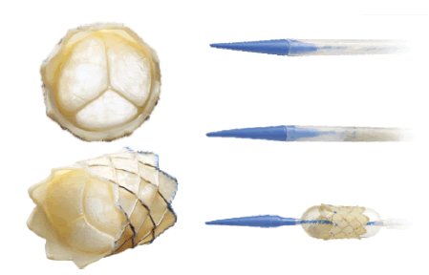
Melody Bioprosthetic Valve
Notes:
Catheter deployed Melody valve.

Slide 38
Melody Valve in Valve (TVR)

Slide 39
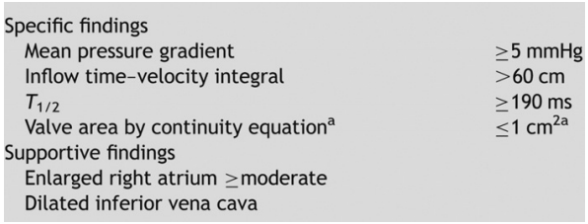
Criteria for Severe TS
H. Baumgartner et al. JASE 2009
Severe TS Criteria
In severe TS, any TR more than mild will result in an underestimation of tricuspid valve area (ie, overestimation of stenosis severity).
Balloon valvuloplasty is not recommended for TS.
Severe PR renders PHT use as unreliable for TV area.
The patient had an acceptable mean diastolic gradient (up to 4 mm Hg)

Slide 40
Case of Mechanical TVR Thrombosis
Clotted TVR before [left] and
after thrombolytic therapy [right]

Slide 41
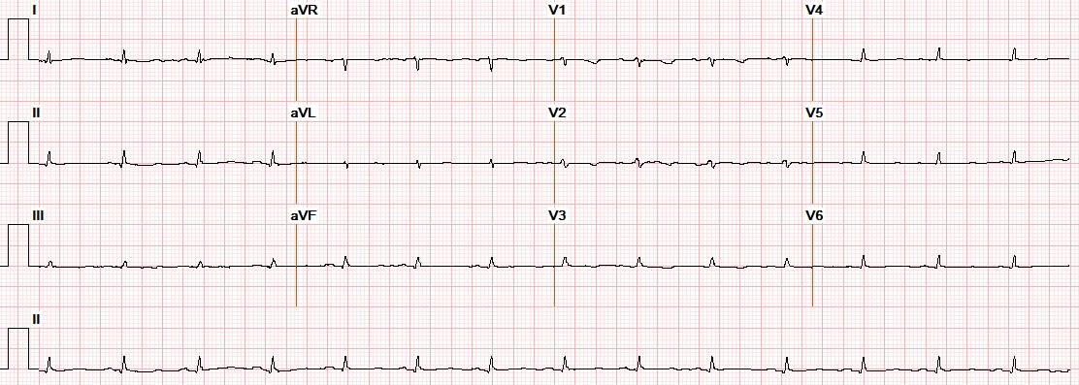
Case 3
32 yo man with h/o schizoaffective disorder, psychosis and syphilis, presents with anasarca.

Slide 42
CXR

Slide 43
PLAX
M-Mode: Paradoxical septal motion (diastolic-inward/systolic outward) indicative of RV volume overload.

Slide 44
RV Inflow
Notes:
Tricuspid valve leaflets are not clearly seen, especially the anterior position. What looks like the TV is actually chordal insertions on the TV annulus (which is small). The right atrium is small.

Slide 45
Tricuspid Leaflet Destruction

Slide 47
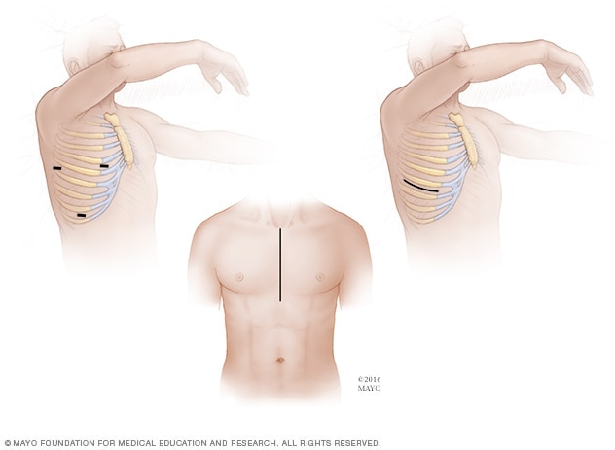
Incision Locations for TVR: Minimally invasive and Midline Approaches

Slide 48
RV Inflow: How Much TR?
MILD MODERATE
SEVERE
Notes:
Severe tricuspid regurgitation is deduced when looking at the TR spectral Doppler tracing which shows an early peaking, triangular shape.

Slide 49
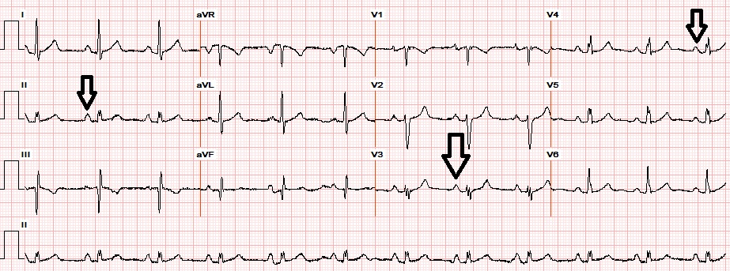
Case 4
30 yo man with known congenital heart abnormality.

Slide 50
CXR
Notes:
CXR shows right heart enlargement.

Slide 51
Right heart enlargement
Notes:
All 3 leaflets of the tricuspid valve can be seen in this short axis.

Slide 53
Notes:
Apical origination of the TR jet is shown as seen in Ebstein anomaly.

Slide 54
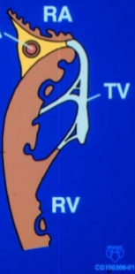
Normal TV

Slide 55
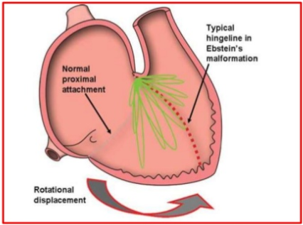
TV Orifice in Ebstein Anomaly
Hinged or rotational displacement of the TV orifice.
Notes:
Instead of downward displacement of the TV orifice, there is rotational displacement as shown by the green lines.

Slide 56
Ebstein Anomaly 5 Points to Remember
1. Septal and posterior leaflets are adherent to the myocardium (failed delamination).
2. Functional annulus is rotated apically with hinge point at septum.
3. Anterior leaflet becomes elongated.
4. Anatomic annulus becomes dilated.
5. The RV subtended by the anatomic and functional TV annuli may be variably thinned and “atrialized”.

Slide 57
Case 5
47 yo woman with dyspnea and holosystolic murmur increasing in intensity on inspiration.
Notes:
Pt is Mary White UMCNO MRN: T100

Slide 58
Very severe TR

Slide 59
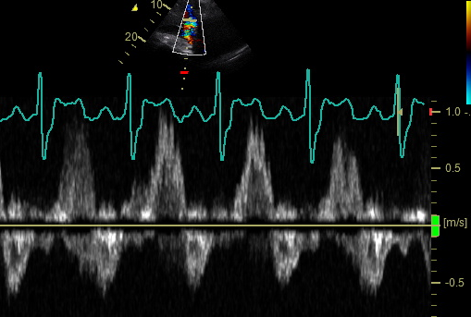
Hepatic Vein Doppler: S wave flow reversal

Slide 60
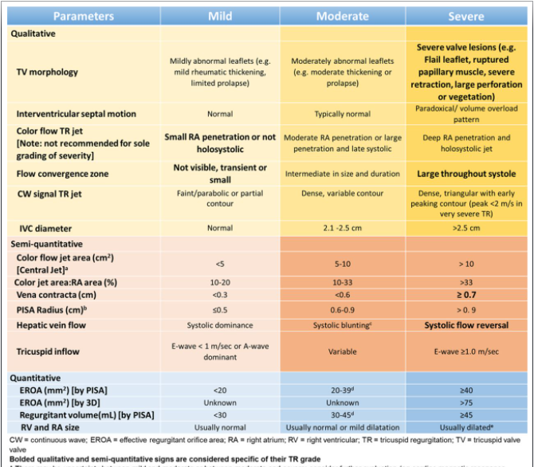
Tricuspid Regurgurgitation Severity Assessment

Slide 61
Tricuspid Regurgitation for RVSP
1. Choose the imaging window with the most optimal insonation angle.
2. Set the sweep speed to 75-150 mm/sec according to heart rate.
3. Avoid using post–PVC beats. In a. fib, use the third beat after two consecutive equal RR intervals
4. Optimize the signal-to-noise ratio by carefully decreasing the Doppler gain, to avoid overestimation of maximal velocities

Slide 62
Tricuspid Regurgitation for RVSP
5. measure the peak velocity only if the signal is interpretable (avoid overreporting).
6. measure the peak TR velocity using the modal frequency.
7. Enhance signal detection with saline contrast, which can also improve the signal-to-noise ratio in estimating TR velocities.
8. Avoid translational motion when assessing the IVC.
Resting IVC
IVC sniff

Slide 63
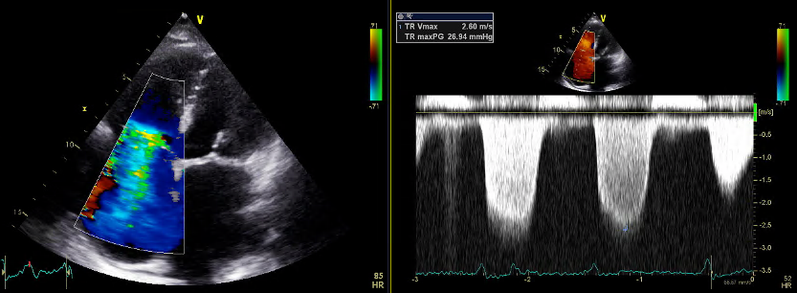
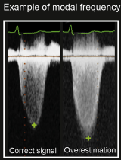
TR Jet Peak Measurement

Slide 64
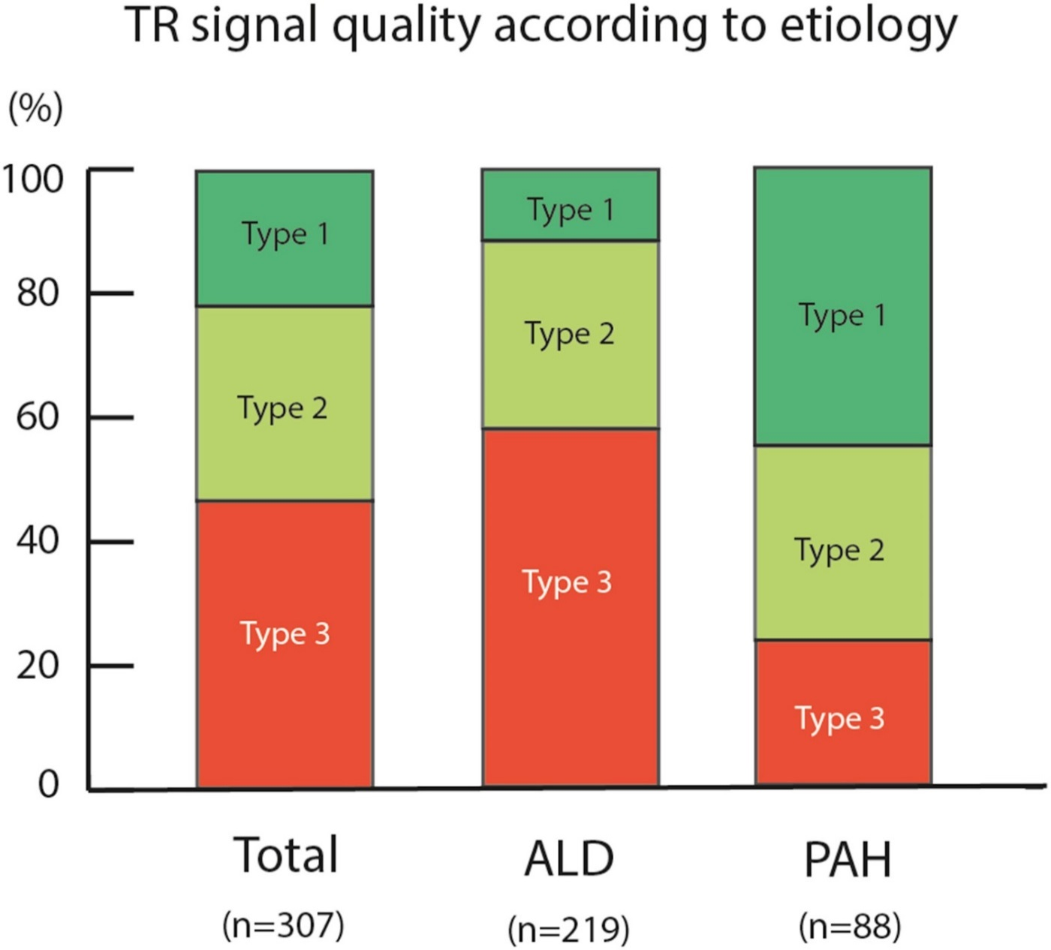
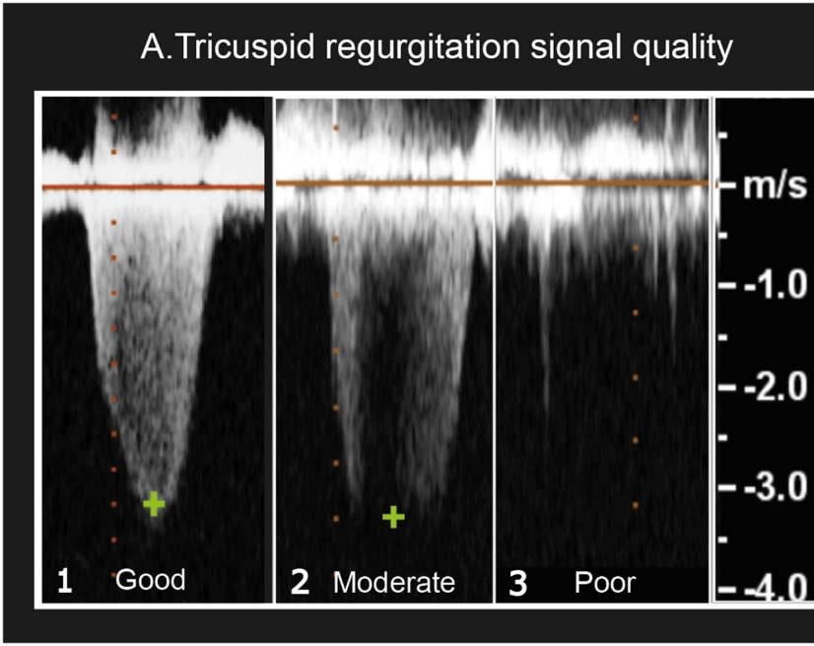
Majority of PAH and Advanced Lung Disease Patients have suboptimal (Type 2 or 3) TR jets
Figure 3
ALD= Advanced Lung Disease
PAH= Pulmonary Arterial Hypertension
Journal of the American Society of Echocardiography 2016 29, 93-102DOI: (10.1016/j.echo.2015.11.001)
Copyright © 2016 American Society of Echocardiography Terms and Conditions
Notes:
TR signal quality according to etiology. TR signal quality was defined as follows: complete envelope as type 1 (dark green), partial envelope but prone to extrapolation as type 2 (light green), and unreliable envelope or no signal as type 3 (red).

Slide 65
Pt referred for RVSP assessment
What happens if we increase the “Gain” setting?

Slide 66
What happens if we increase the “2D Gain” setting?

Slide 68
What happens if we increase the “Compress” setting?

Slide 69
What happens if we increase the “Reject” setting?

Slide 71
Settings Comparison
Initial
Current

Slide 72
Sweep Speed @ 50 mm/s

Slide 73
Sweep Speed @ 66.7 mm/s

Slide 74
Sweep Speed @ 100 mm/s

Slide 75
Final Optimization

Slide 76
Sweep speed @ 25 mm/s
Can over-estimate the peak velocity, especially
if the Doppler velocity scale limit is too high.

Slide 77
Contrast Echo Doppler for TR
Administration of agitated saline bubbles while interrogating TR jet with CW Doppler can improve the jet envelope contour detection.

Slide 78
Tricuspid Stenosis
Usual cause world wide is rheumatic.
Carcinoid (typically TS and TR)
Thickened/retracted leaflets & subvalvular apparatus.
Leaflets become fixed in a semi-open position
Normal mean gradient is < 2 mm Hg.
Mean gradient is reproducibly assessed while patient is breath-holding in end-expiration.
Suggested formula for TV Area = 190 / PHT
Severe TS exists when mean gradient ≥5 mm Hg or PHT > 190.

Slide 79
Carcinoid TS/TR: Example 1
Add image and relevant facts

Slide 80
Carcinoid TS/TR: Example 2
Add image and relevant facts

Slide 81
Compare with this Ebstein case
RV Inflow View:
Long anterior leaflet with closure displaced apically from anatomic TV annulus.
P-SAX view:
Non-delaminated septal leaflet stuck to IVS.
TR jet starts well within RV.

Slide 82
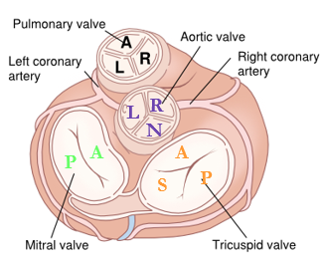
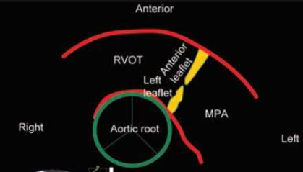
Pulmonic Valve
PS (subvalvular, valvular, branch) is almost always congenital in origin.
Dysplastic (non-calcified) leaflets; post stenotic dilatation of the PA.
Highest gradient might be seen in subcostal window.
PULMONIC STENOSIS

Slide 83
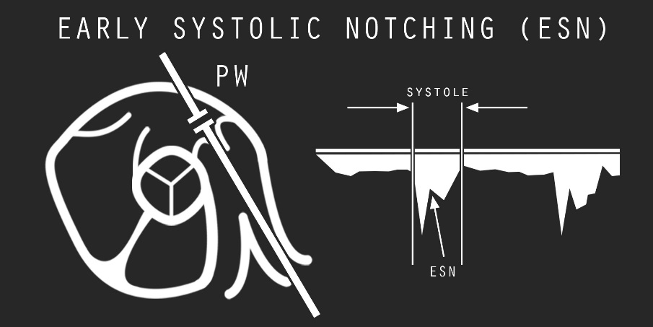
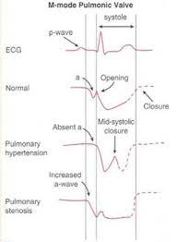
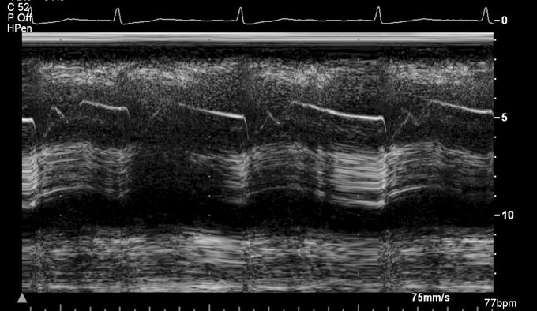
Pulmonic Stenosis & Pulm-HTN
RVOT PW Doppler
Trans-pulmonic CW Doppler
Trans-pulmonic M-Mode (“Flying W”)

Slide 84
PS & Pregnancy
PS, even when severe, is generally well tolerated during pregnancy.
Severe PS may result in RV failure and arrhythmias.
Chance of preterm birth and offspring mortality is increased.
Relief of PS prior to pregnancy is ideal, using balloon valvuloplasty, and should be performed when the peak gradient is > 64 mm Hg.
Patients with mild or moderate PS are regarded as low risk.
Balloon valvuloplasty is only rarely indicated during pregnancy
unresponsive to medical therapy and bed rest.
Vaginal delivery > Caesarian is preferred delivery method.

Slide 85
Pulmonic Valve Endocarditis

Slide 86
RVOT / PV view: Any Issue Seen?

Slide 87
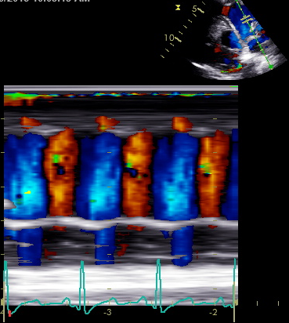
RVOT Color M-Mode
Both blue and orange signals are laminar.
Indicates to and fro movement of blood
Orange flow in diastole represents pulmonic regurgitation (wide open).

Slide 88
Pro Tip: Widen the P-SAX Color Sector for Severe PI or TS Visualization
Notes:
The RA is enlarged when illuminated with color TR jet. A swirling of color around the heart is seen in this patient with severe PI and severe TR.

Slide 89
Question 1
Unlike the relationship of the mitral and aortic valve leaflets, it is uncommon to see direct extension of tricuspid valve endocarditis to the pulmonic valve due to the presence of what anatomic RV structure?
A. Moderator band
B Ventriculo-infundibular fold
C. Crista terminalis
D. Septomarginal band

Slide 90
Question 2
Which of the following is LEAST effective in improving
RVSP assessment accuracy from the following TR jet
spectral Doppler envelope?
A. Set the sweep speed to 100 mm/s.
B. Increase the 2D gain
C. Increase the dynamic range.
D. Administer saline bubbles.
E. Decrease displayed Doppler velocity scale.

Slide 91
Question 2
Which of the following is LEAST effective in improving
RVSP assessment accuracy from the following TR jet
spectral Doppler envelope?
A. Set the sweep speed to 100 mm/s.
B. Increase the 2D gain
C. Increase the dynamic range.
D. Administer saline bubbles.
E. Decrease displayed Doppler velocity scale.
Better to lower scale limit from 6 to 4 m/s

Slide 92
Question 3
Which of the following is correct regarding typical findings associated with Ebstein anomaly?
A. Septal and anterior leaflet fusion resulting in TR.
B. RV-laminated, sail-like anterior TV leaflet.
C. Decreased size of anatomic TV annulus.
D. Apical rotation of functional TV annulus
E. Increased right ventricular volume.

Slide 93
Question 4
A patient diagnosed recently with a small anterior leaflet TV vegetation presents for repeat TTE. Which of the following views is most likely to show the anterior TV leaflet?
A. Parasternal RV inflow
B. Parasternal short axis.
C. Apical RV focused.
D. Apical 3 chamber.
E. Apical 4 chamber.

Slide 94
Question 5
What is the cause of the blue Doppler signal in the subpulmonic/RVOT region on this TTE?
A. PR with inverted Nyquist.
B. PR with too low Nyquist limit and aliasing.
C. VSD associated with Trisomy 21.
D. VSD associated with Fallot’s Tetralogy.
E. Something else/Don’t know

Slide 95
Question 5

Slide 96
Question 6
A 29 year old woman is in her second trimester of pregnancy. Due to systolic murmur and mild exertional dyspnea, an echocardiogram is performed with the following CW tracing across the pulmonic valve. Which of the following correctly characterizes the next step in pregnancy counseling?
A. Continue pregnancy, PS is no biggie
B. PS gradient warrants balloon valvuloplasty.
C. PS gradient warrants pregnancy termination.
D. What PS ?? You mean supracristal VSD.

Slide 97
Question 7
30 yo woman is s/p TOF repair with bioprosthetic valve. Images shown are from standard parasternal windows. Based upon the images, which of the following is LEAST LIKELY to be found?
A. RV hypo-
kinesis
B. Sinus rhythm
C TS & TR
D. PS & PR
E. Elevated RVEDP.
F. RAp > PA diastolic pressure before S1 heart sound
G. All above are demonstrated
Notes:
Knowledge and understanding of TOF includes management of pulmonic stenosis, which in this case a bioprosthetic valve was mentioned in the question stem. The tricuspid valve is not usually involved in any TOF classical pathology and thus TS and TR should not be expected at any point in the patient’s lifetime. There is end diastolic forward flow seen through the pulmonic valve just before the onset of systole (S1 auscultatory sound). Steep slope of PI jet indicates elevated RVEDP with equalization of pressures. Transmitral M mode clearly shows opening of the mitral valve late in diastole associated with presumably sinus rhythm, though the ECG tracing voltage gain is set low.

Slide 98
End-Diastolic Forward Flow across PV
RVDP=PADP
Steep PR Slope
RAP>PADP
Atrial Kick
Normal PI jet

Slide 99
Questions 8,9,10: TRUE or FALSE
Diastolic tricuspid VTI of 30cm → Severe TS?
FALSE. >60 cm = severe TS.
Tricuspid pressure half time < 190 msec → Severe TS?
FALSE. GREATER THAN 190 msec = severe TS.
Tricuspid regurgitant volume of 50 cc/beat → severe TR?
TRUE. Tricuspid RV > 45 mL qualifies as severe.

Slide 100
Thank you for your dedication to CV Imaging Quality! Certification Matters!

